Slide 1








Awareness & Acquisition
Onboarding
Account Setup
&
Activation
Banking
& Engagement
Resolution &
Servicing
Cross-Sell Products
Reengagement
or
Churn
Online Ads
KYC Docs
Application Install
Direct Mail
Account Center
First Fund / Transaction
Email offers
Setup Alerts
Social Media
Email & SMS Comms

Slide 2

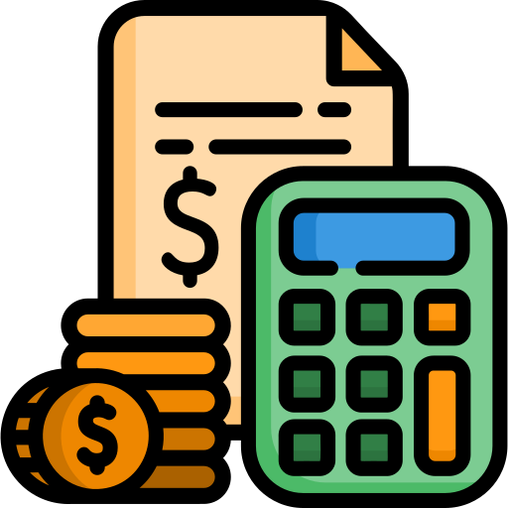


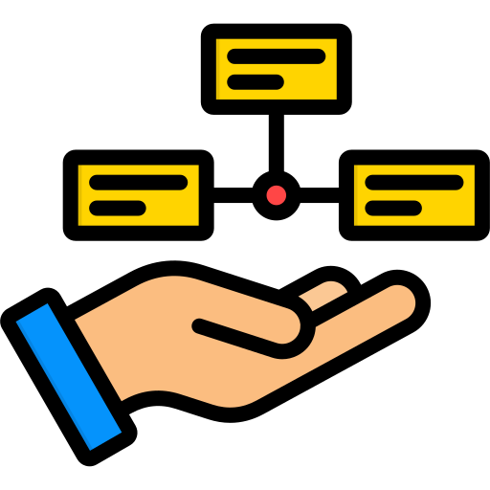


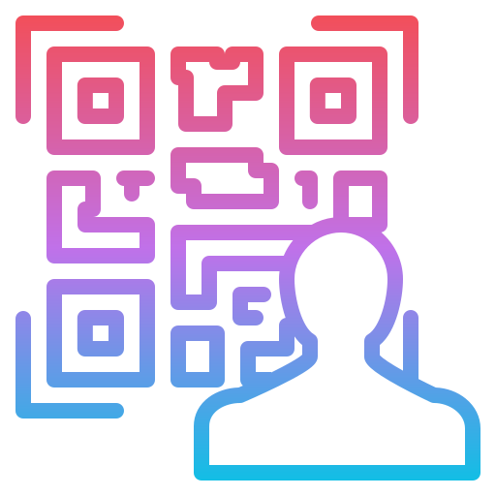
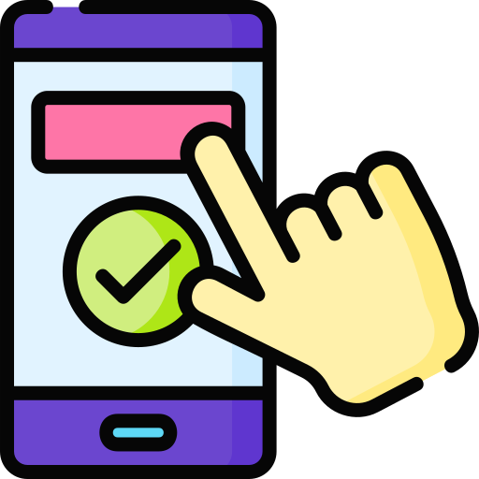
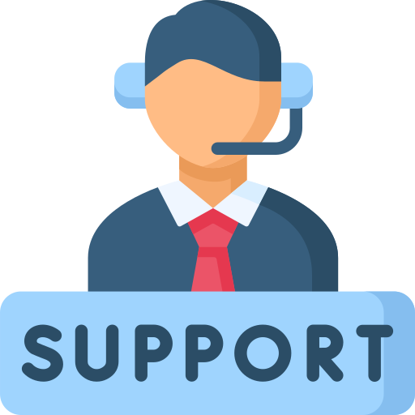
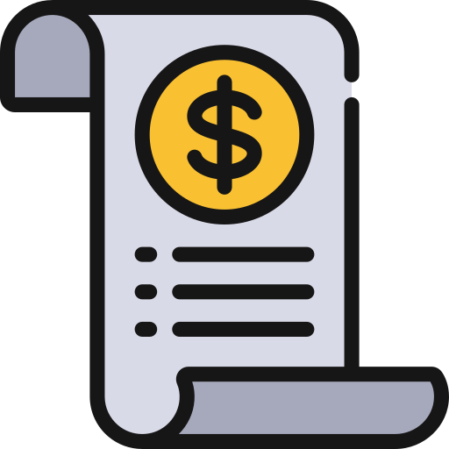


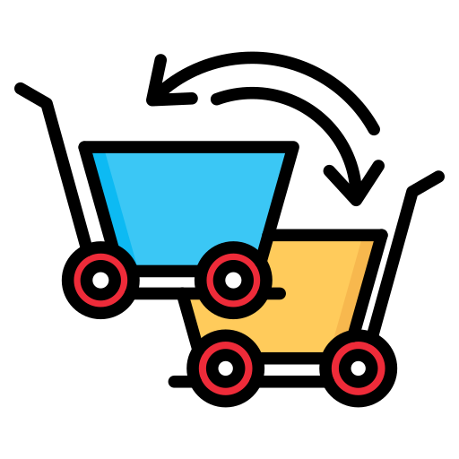




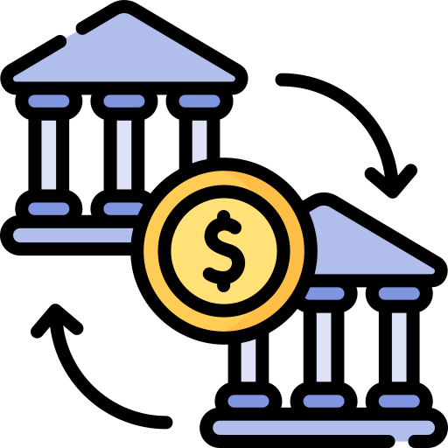

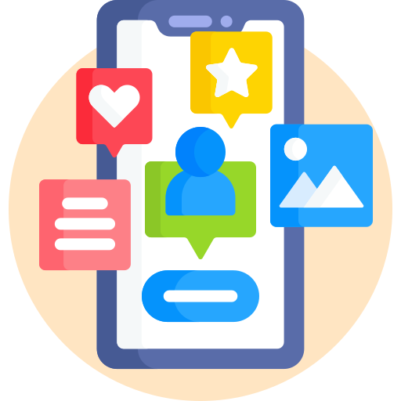

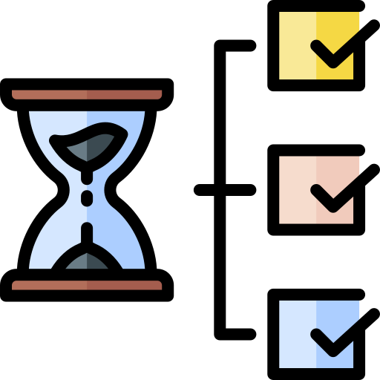

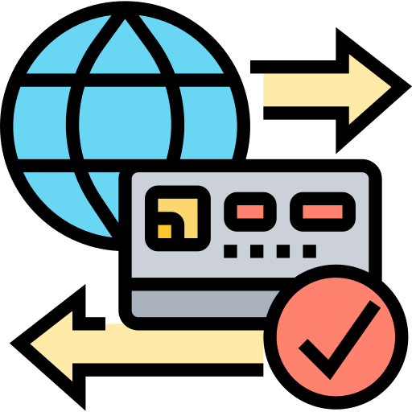

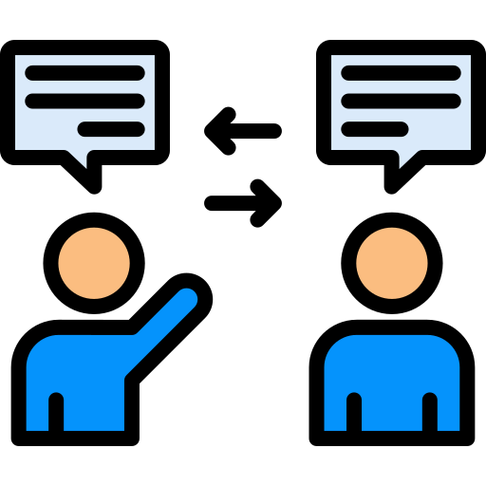






Prospect to Customer Journey
LOGS OFF/LOGS BACK IN
EMAIL REMINDER RE-TARGETING
VISITS PRODUCT FEATURES/FAQ/ELIGIBILITY/EMI CALCULATOR PAGES
NAVIGATES TO WEB/APP
RETURN TO APP
ABANDONS APP
STARTS FILLING APPLICATION
PROSPECT ENCOUNTERS BRAND
DROPS TO CONTACT SUPPORT
SERVICING ACTIVITIES AND ENGAGEMENT
CONTACTS SUPPORT & RESUMES
RESUMES SESSION
RESTARTS SESSION
SUBMIT APPLICATION
OMNI-CHANNEL MARKETING CAMPAIGNS
ABANDONS SESSION
CONTACTS CUSTOMER SUPPORT / LIVE AGENT
KYC
CHECK STATUS ON WEB/APP
ACCOUNT SIGN UP / FIRST TRANSACTION / ACCOUNT FUNDED
ADDITIONAL DETAILS OVER EMAIL/PHONE/APP
DOCUMENT / PII SUBMISSION
DECISIONING
ADVERSE ACTION COMMUNICATION
WELCOME EMAIL
+
SIGN UP INFORMATION
APPLICATION DECLINED
APPROVAL
+ ONBOARDING

Slide 3
Prospect to Customer Journey
LOGS OFF/LOGS BACK IN
EMAIL REMINDER RE-TARGETING
VISITS PRODUCT FEATURES/FAQ/ELIGIBILITY/EMI CALCULATOR PAGES
NAVIGATES TO WEB/APP
RETURN TO APP
ABANDONS APP
STARTS FILLING APPLICATION
PROSPECT ENCOUNTERS BRAND
DROPS TO CONTACT SUPPORT
SERVICING ACTIVITIES AND ENGAGEMENT
CONTACTS SUPPORT & RESUMES
RESUMES SESSION
RESTARTS SESSION
SUBMIT APPLICATION
OMNI-CHANNEL MARKETING CAMPAIGNS
ABANDONS SESSION
CONTACTS CUSTOMER SUPPORT / LIVE AGENT
KYC
CHECK STATUS ON WEB/APP
ACCOUNT SIGN UP / FIRST TRANSACTION / ACCOUNT FUNDED
ADDITIONAL DETAILS OVER EMAIL/PHONE/APP
AWARENESS & PROSPECTING
DOCUMENT / PII SUBMISSION
CONSIDERATION & EXPLORATION
DECISIONING
APPLICATION
ADVERSE ACTION COMMUNICATION
WELCOME EMAIL
+
SIGN UP INFORMATION
ONBOARDING
APPLICATION DECLINED
APPROVAL
+ ONBOARDING
SERVICING & BANKING ENGAGEMENT
APPLICATION DECLINE

Slide 4

MARKETING
OFFERS
WEB INTERACTIONS
APP INTERACTIONS
LIVE CHAT METADATA
+ TRANSCRIPTS
CALL
METADATA
+ TRANSCRIPTS
CORRESPONDENCE
TRANSACTIONS

Slide 5
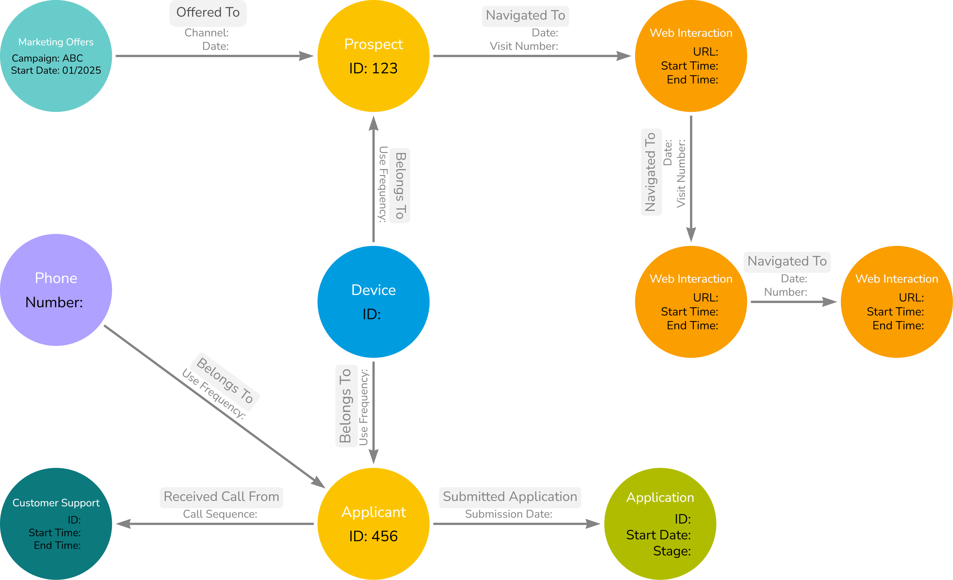

Slide 6

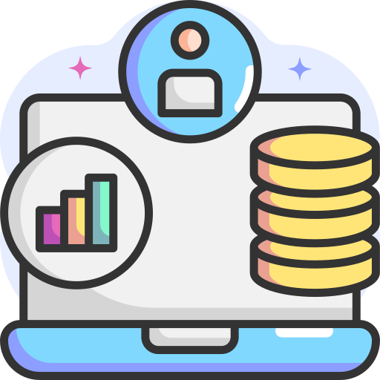

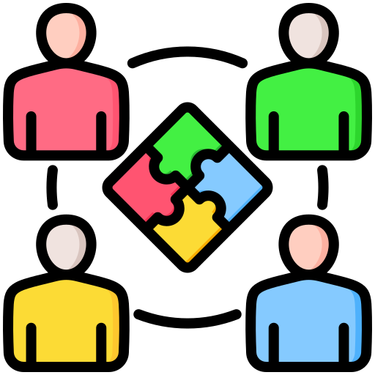
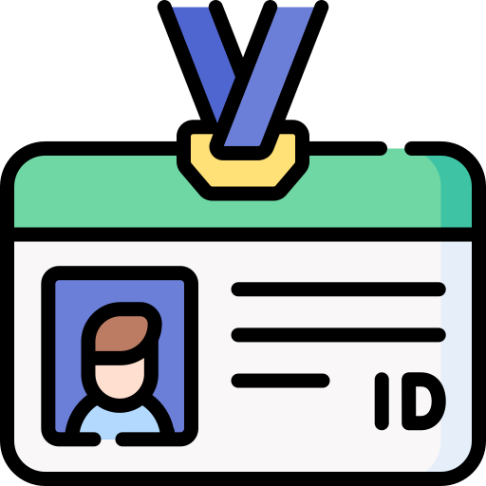




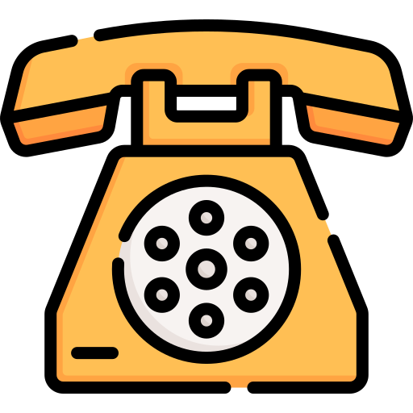



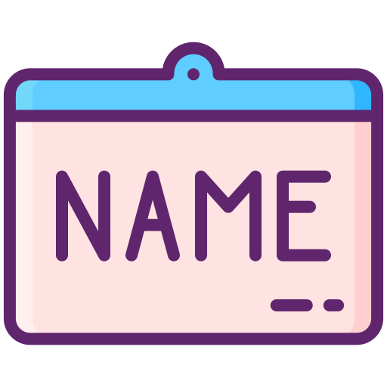
Multi-touch Attribution Across Channels
UNIDENTIFIED VISITOR
PROSPECT TOUCHPOINTS DATA
BROWSE WEBSITE
CAMPAIGN EMAIL
IDENTIFIED PROSPECT
EMAIL OPENED
BROWSE APP
PAGEVIEWS/SCROLLS/CLICK PATHS/VISITOR ID
TIES VISITOR ACTIVITY TO EXISTING USER
VISITOR IDENTIFIED FOR CHANNEL-ATTRIBUTION
OUTBOUND CALL
IDENTIFIED PROSPECT
PHONE ANSWERED
BROWSE WEBSITE
Household-level Marketing and Influence Analysis
LAST NAME FUZZY MATCH
LAST NAME EXACT MATCH
MATCH SIMILAR FEATURES
CLASSIFY AS HOUSEHOLD

Slide 7







Powering Re-engagement Strategies
COMPARE DEVICE INFO
MATCHED DEVICE INFO
DEVICE PAGE VIEWS
STARTS APPLICATION
DROPS OFF
UNIDENTIFIED VISITOR SESSION
RE-ENGAGEMENT STRATEGY
PERSONALIZED RE-ENGAGEMENT MAIL
De-duplication and Identity Resolution via Exact/Partial Matched attributes
CUSTOMER 1
FUZZY + RULE-BASED MATCHING
UNIFIED CUSTOMER IDENTITY WITH CONFIDENCE LEVEL
CUSTOMER 2
PARTIAL/FULL OR MISMATCH OF ATTRIBUTES

Slide 8
Powering Re-engagement Strategies
COMPARE DEVICE INFO
MATCHED DEVICE INFO
DEVICE PAGE VIEWS
STARTS APPLICATION
DROPS OFF
UNIDENTIFIED VISITOR SESSION
RE-ENGAGEMENT STRATEGY
PERSONALIZED RE-ENGAGEMENT MAIL
De-duplication and Identity Resolution via Exact/Partial Matched attributes
CUSTOMER 1
FUZZY + RULE-BASED MATCHING
UNIFIED CUSTOMER IDENTITY WITH CONFIDENCE LEVEL
CUSTOMER 2
PARTIAL/FULL OR MISMATCH OF ATTRIBUTES

Slide 9
Multi-touch Attribution Across Channels
UNIDENTIFIED VISITOR
PROSPECT TOUCHPOINTS DATA
BROWSE WEBSITE
CAMPAIGN EMAIL
IDENTIFIED PROSPECT
EMAIL OPENED
BROWSE APP
PAGEVIEWS/SCROLLS/CLICK PATHS/VISITOR ID
TIES VISITOR ACTIVITY TO EXISTING USER
VISITOR IDENTIFIED FOR CHANNEL-ATTRIBUTION
OUTBOUND CALL
IDENTIFIED PROSPECT
PHONE ANSWERED
BROWSE WEBSITE
Household-level Marketing and Influence Analysis
LAST NAME FUZZY MATCH
LAST NAME EXACT MATCH
MATCH SIMILAR FEATURES
CLASSIFY AS HOUSEHOLD

Slide 10
🔹 1. Awareness & AcquisitionGoal: Customer becomes aware of bank and chooses to open an account.Aspect DetailsTouchpoints Online ads, website, referral, in-branch signage, social mediaCustomer Actions Browses options, compares banks, reads reviewsCustomer Goal Find a trustworthy bank with suitable productsEmotions Curious, cautiousBank Systems Marketing automation, CRM, web analytics, lead scoring tools🔹 2. OnboardingGoal: Customer successfully opens an account and sets up services.Aspect DetailsTouchpoints Branch, mobile app, website, call centerCustomer Actions Applies for account, verifies identity, funds accountCustomer Goal Quick, easy account opening with minimal frictionEmotions Optimistic, slightly anxiousBank Systems KYC, onboarding workflow engine, eKYC, AML systems🔹 3. Account Setup & Product ActivationGoal: Customer activates debit card, sets up direct deposit, and explores other services.Aspect DetailsTouchpoints Email, SMS, mobile app, websiteCustomer Actions Sets PIN, links payroll, downloads mobile app, sets up alertsCustomer Goal Get ready to use banking services confidentlyEmotions Excited, testing trustBank Systems Card management, digital banking, customer success tools🔹 4. Daily Banking & EngagementGoal: Regular usage of bank services — transactions, payments, budgeting tools.Aspect DetailsTouchpoints Mobile app, ATM, email, call center, in-personCustomer Actions Checks balances, pays bills, uses card, sets goals, chats with supportCustomer Goal Seamless, fast access to everyday bankingEmotions Confident, comfortableBank Systems Core banking, mobile platform, support CRM, transaction engine🔹 5. Cross-sell & ExpansionGoal: Customer adds new products (credit card, savings account, loan, insurance)Aspect DetailsTouchpoints App push notification, advisor meeting, website offers, emailCustomer Actions Evaluates and applies for other productsCustomer Goal Grow financial relationship with minimal effortEmotions Curious, evaluating trustBank Systems Recommendation engines, credit decisioning, campaign management🔹 6. Issue Resolution & ServicingGoal: Customer encounters issues or questions and seeks resolution.Aspect DetailsTouchpoints Chatbot, call center, branch, app supportCustomer Actions Disputes charge, changes address, reports lost cardCustomer Goal Fast, empathetic, resolution of concernsEmotions Frustrated → relieved (if handled well)Bank Systems Case management, ticketing, IVR, knowledge base🔹 7. Retention & LoyaltyGoal: Customer receives benefits, rewards, and consistent value.Aspect DetailsTouchpoints Loyalty program, personalized offers, feedback surveysCustomer Actions Redeems rewards, refers friends, reviews experienceCustomer Goal Feel valued and stick with the bankEmotions Appreciated, loyalBank Systems Loyalty engine, NPS/CSAT tracking, customer profiling🔹 8. Risk or ChurnGoal: Prevent customer from leaving due to poor service or competitive offers.Aspect DetailsTouchpoints Call from retention team, survey, app interactionCustomer Actions Stops using account, considers switching, complainsCustomer Goal Evaluate whether to stay or leaveEmotions Disappointed, uncertainBank Systems Churn prediction models, winback campaigns, exit feedback analysis🔹 9. Re-engagement or OffboardingGoal: Either win the customer back or gracefully end the relationship.Aspect DetailsTouchpoints App, email, survey, branch visitCustomer Actions Closes account, provides feedback, or re-engages via winback offerCustomer Goal Leave cleanly or restart relationship if improvedEmotions Finality, closure, or hopefulness (if re-engaged)Bank Systems Closure workflows, customer exit analysis, reactivation campaigns

